Slide 1

Community healthcare
INFO-5100
Team Members: Manali Sanjay Raut Shreya Raut Kunal Singh Pundir

Slide 2

OUR BIG IDEA
Our mission is to be the foremost leader in online healthcare, dedicated to delivering personalized healthcare services that cater to the individual needs and expectations of every patient Globally.

Slide 3

Problem Statement
The problem statement highlights the challenges in current healthcare systems, including fragmented patient data, inefficient appointment scheduling, delayed diagnosis and treatment, limited emergency service accessibility, ineffective medicine supply chain management, and insufficient government oversight. To address these issues and enhance healthcare quality and efficiency, a comprehensive Healthcare Management System is needed.
1. Fragmented patient data: Information scattered across systems, hindering care coordination.
2. Inefficient appointment scheduling: Centralized system needed to prevent conflicts, long waits, and missed appointments.
3. Delayed diagnosis and treatment: Incomplete records and coordination issues impact patient health.
4. Limited emergency service access: Communication barriers and dispatch inefficiencies hinder access.
5. Ineffective medicine supply chain: Poor tracking leads to medication shortages.
6. Insufficient government oversight: Inadequate reporting and transparency in healthcare.

Slide 4

Proposed Solution
Doctor Management:
Implement a user-friendly interface for doctors to view and manage their schedules.
Integrate a system for handling blood test requests and issuing prescriptions digitally.
Include notification features to alert doctors about upcoming appointments or urgent test requests.
Patient Management:
Develop a secure patient portal where they can schedule appointments and request emergency ambulance services.
Provide functionalities for patients to view their lab reports, prescriptions, and donate blood.
Implement a feedback system for continuous improvement based on patient experiences.
Lab Centers:
Create a streamlined process for managing and prioritizing test requests.
Establish a secure system for uploading and accessing lab results.
Integrate with Doctor and Patient Management modules for seamless information flow.

Slide 5
Proposed Solution (CONTINUED…)
4.Blood Donation Management:
Develop a database to track blood donations and donor information.
Implement a matching algorithm to efficiently manage blood type compatibility and urgency.
Integrate with Patient Management for potential donors to sign up and track their donation history.
5.Emergency Ambulance Management:
Design a real-time tracking system for ambulance locations and availability.
Include a feature for emergency dispatch based on location proximity and urgency.
Ensure seamless communication channels between patients, dispatchers, and ambulance personnel.
6.Pharmacy Management:
Build an inventory management system to track and manage medicine stocks.
Integrate with Doctor Management for prescription processing and dispensing.
Implement a notification system for low-stock alerts and expiration tracking.

Slide 6
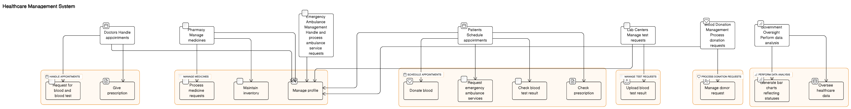
Architecture Diagram

Slide 7
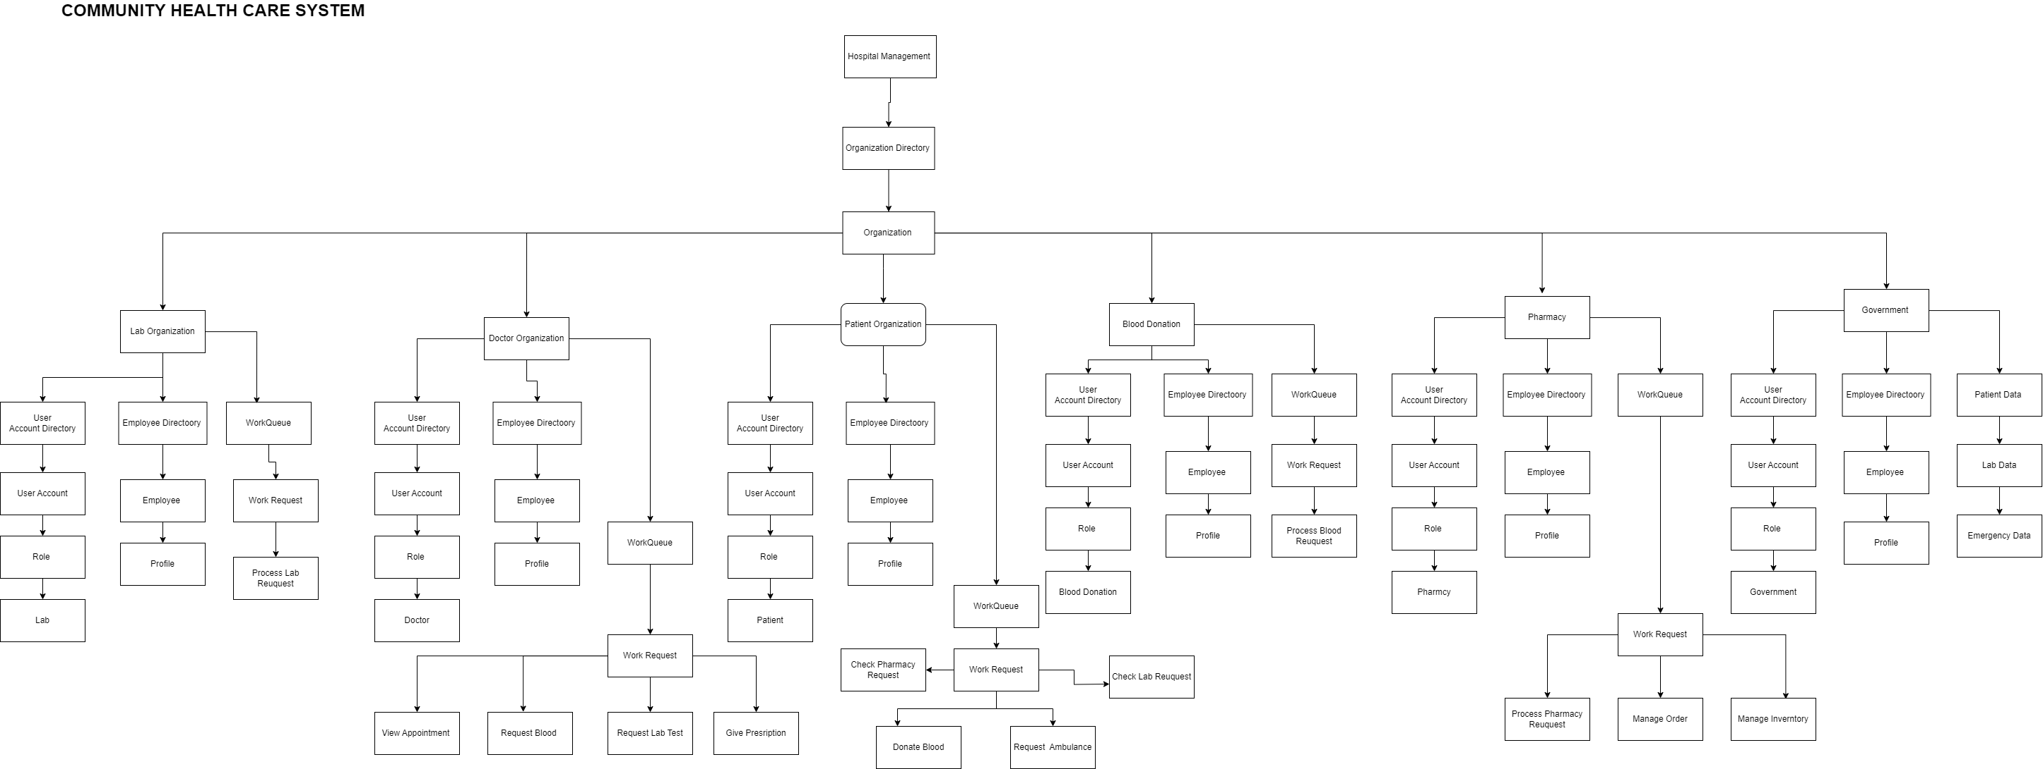
Object Model

Slide 8
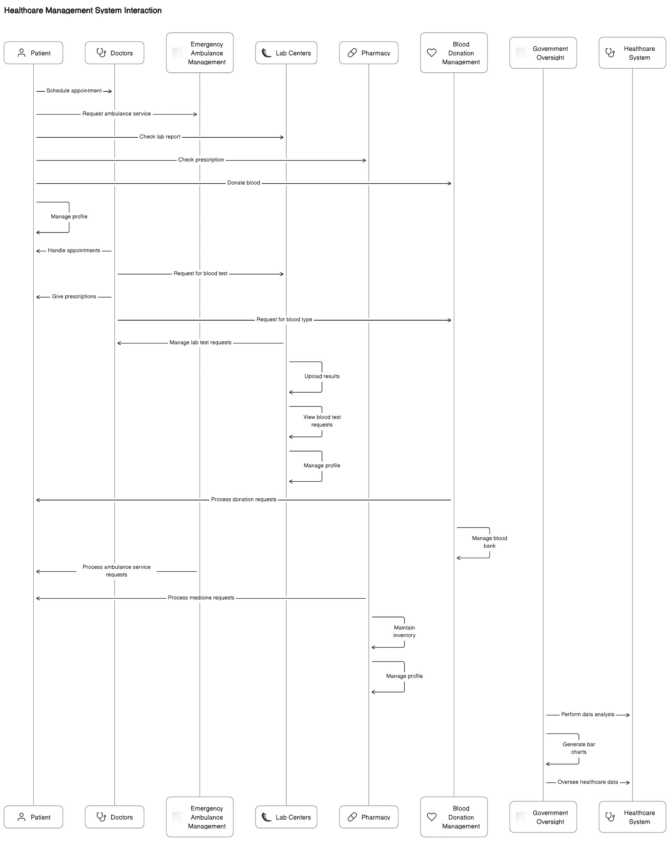
Sequence Diagram

Slide 9
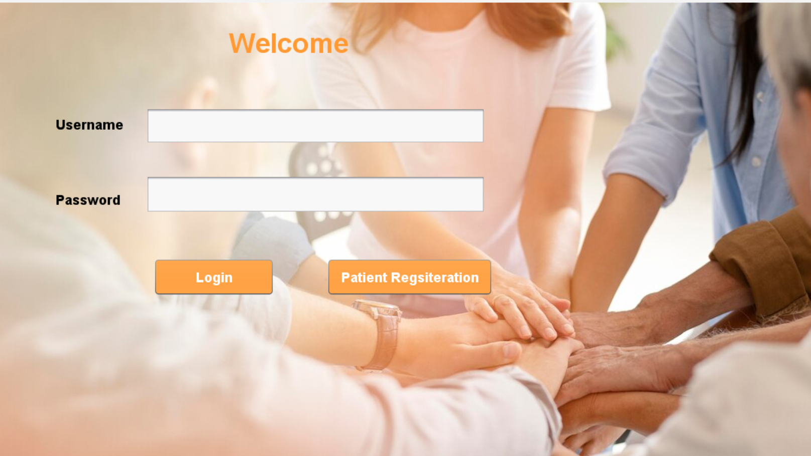
Application Walkthrough

Slide 10
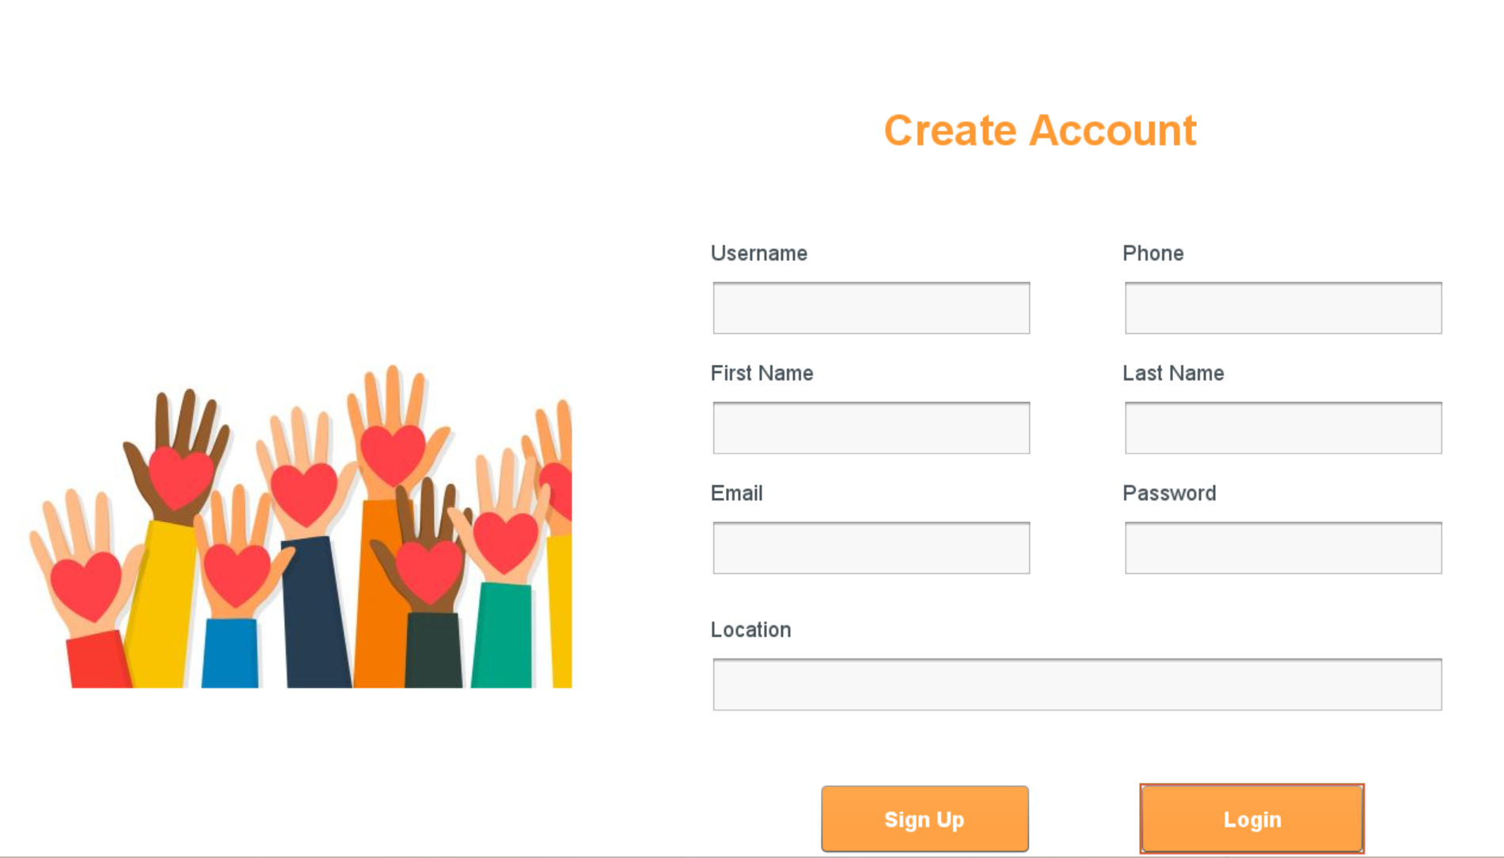
Application Walkthrough

Slide 11
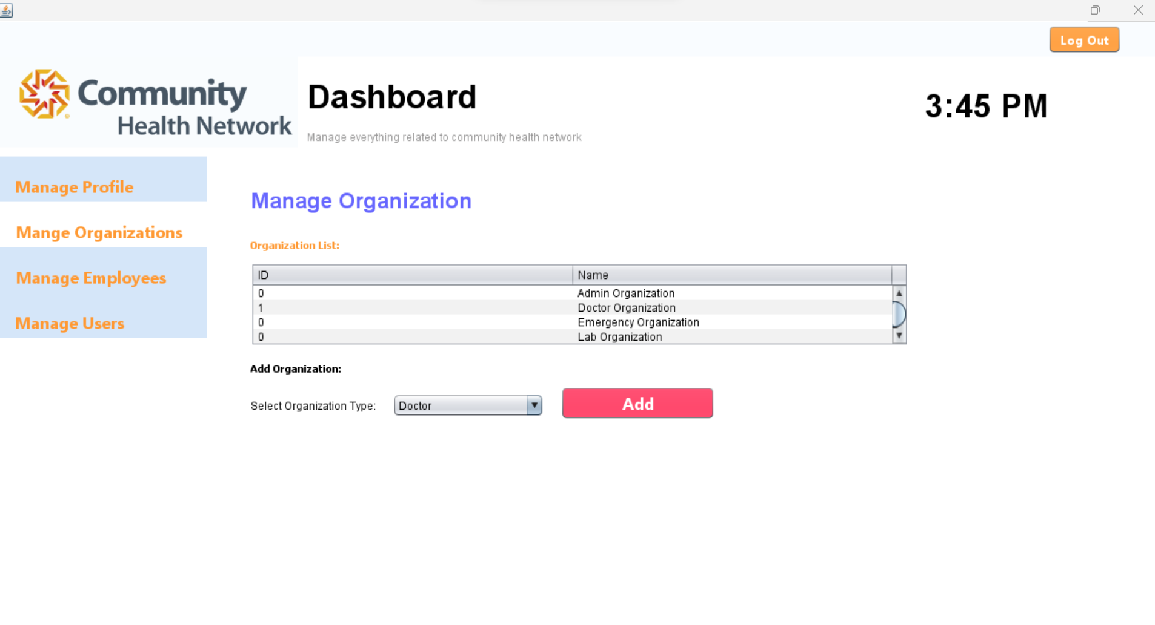
Application Walkthrough

Slide 12
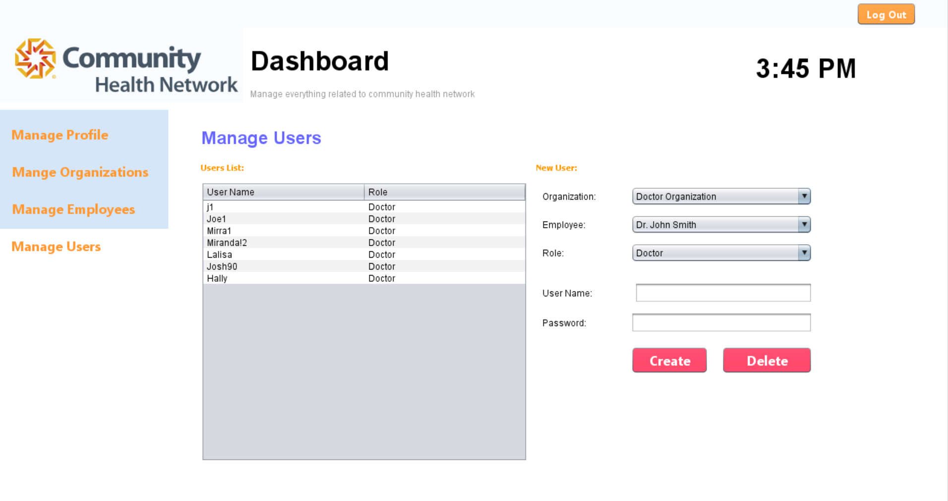
Application Walkthrough

Slide 13

Application Walkthrough

Slide 14
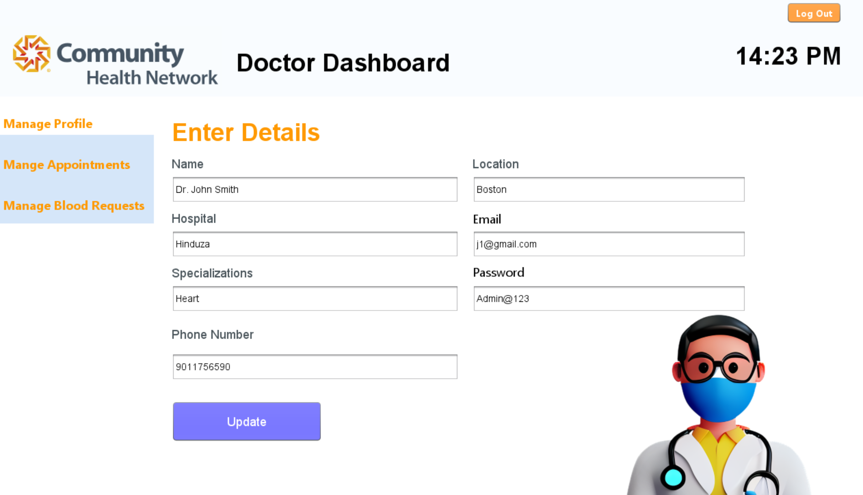
Application Walkthrough

Slide 15
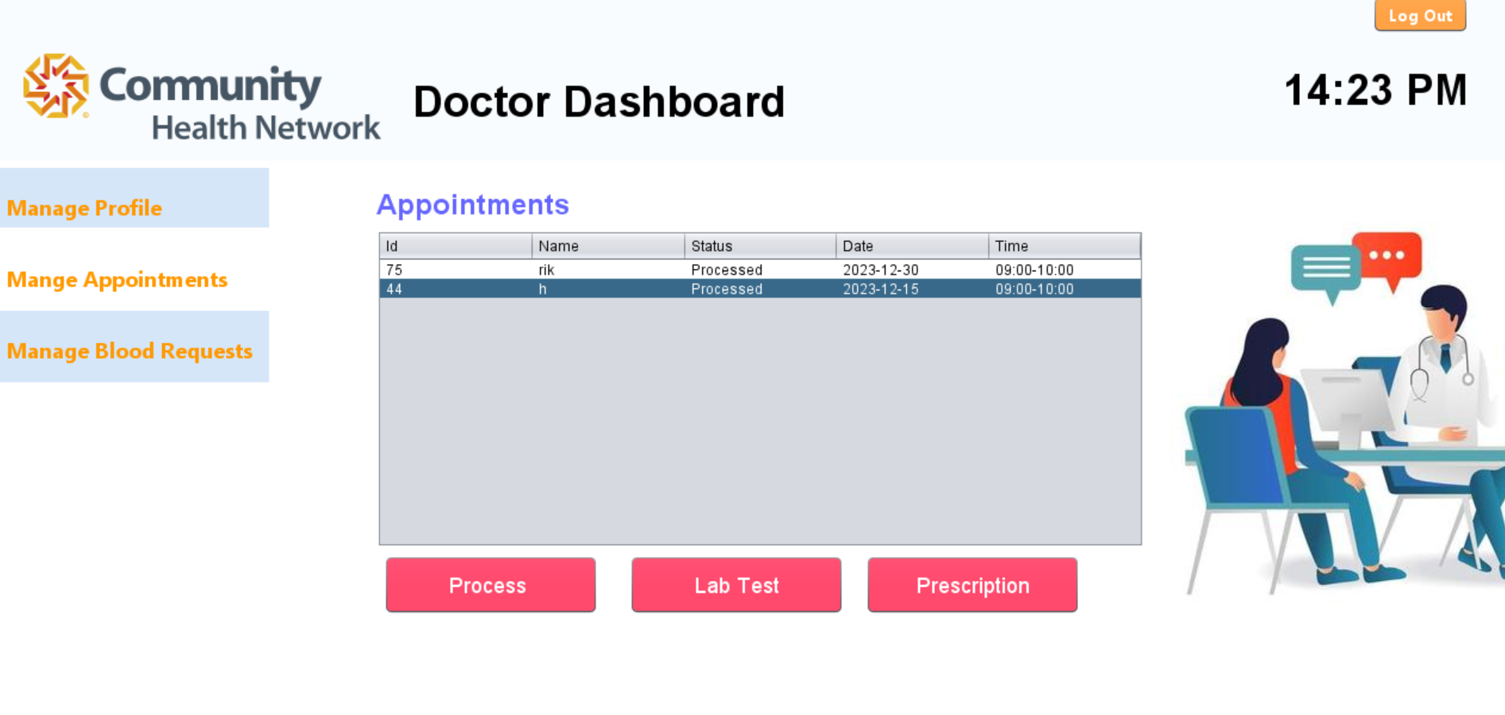
Application Walkthrough

Slide 16
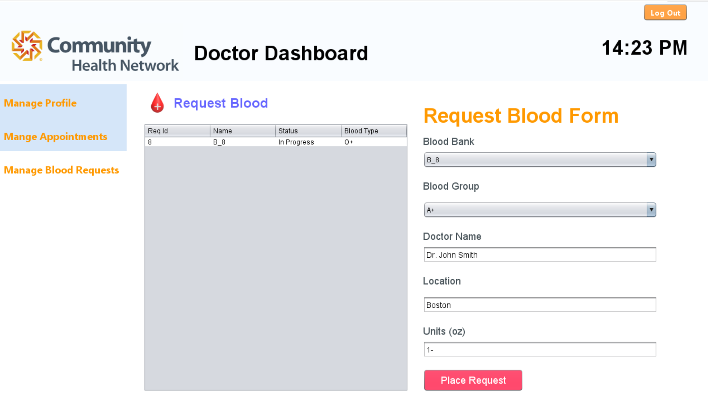
Application Walkthrough

Slide 17
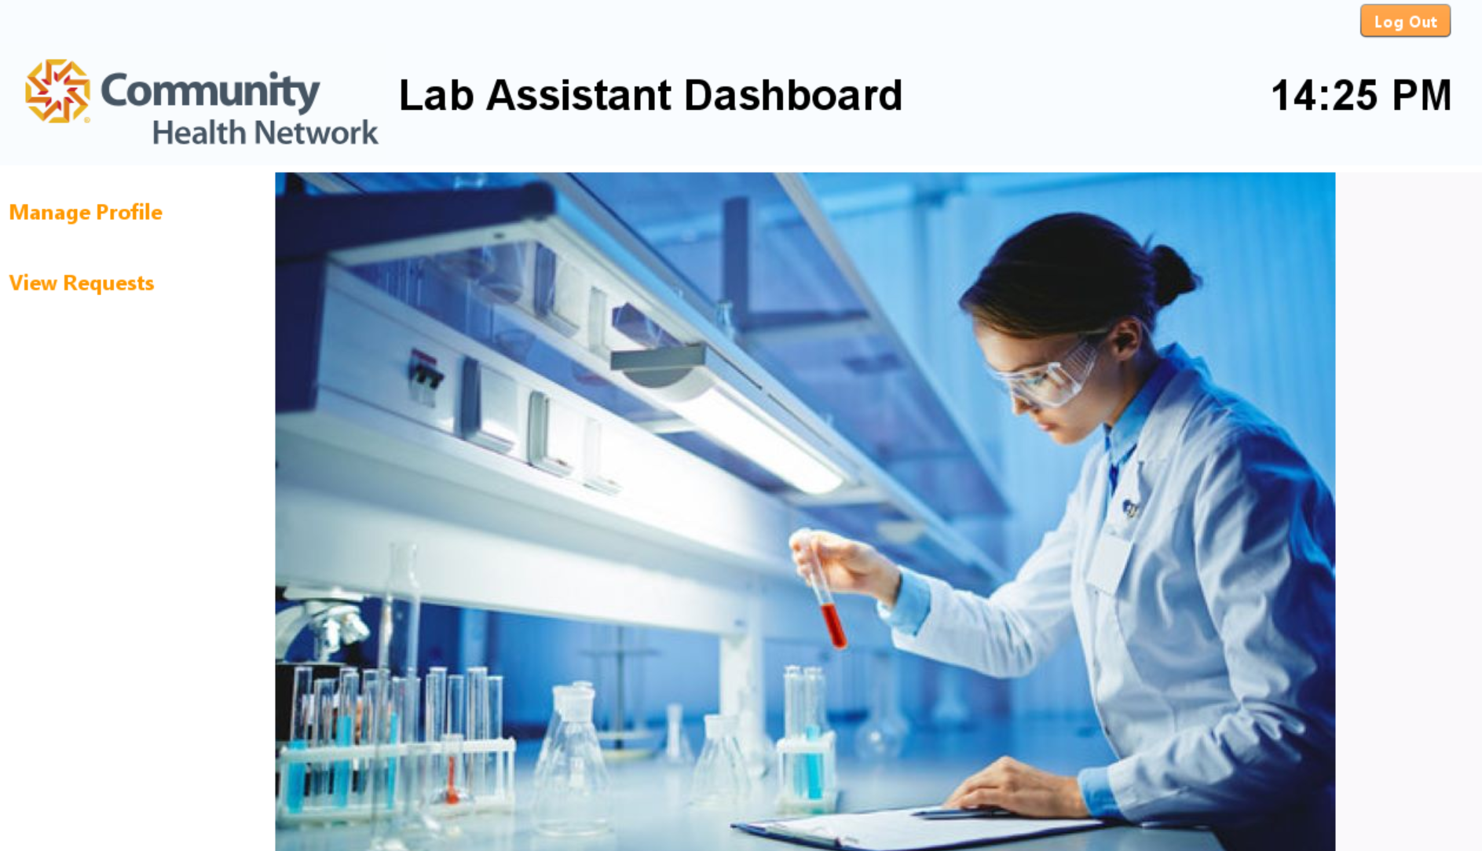
Application Walkthrough

Slide 18
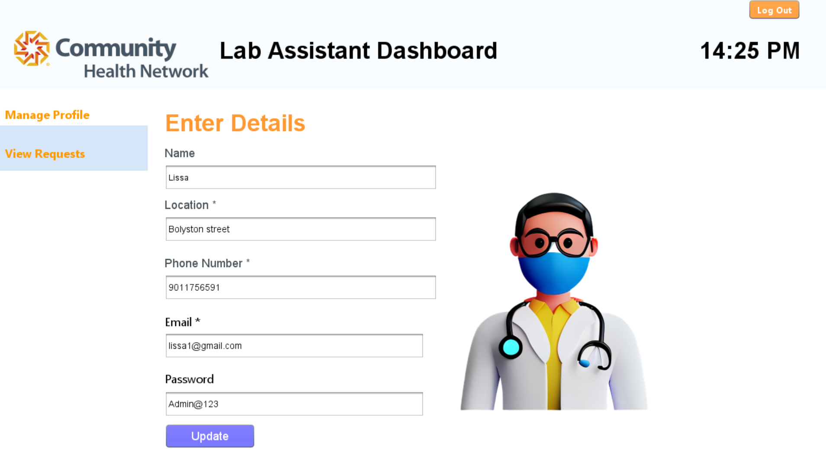
Application Walkthrough

Slide 19
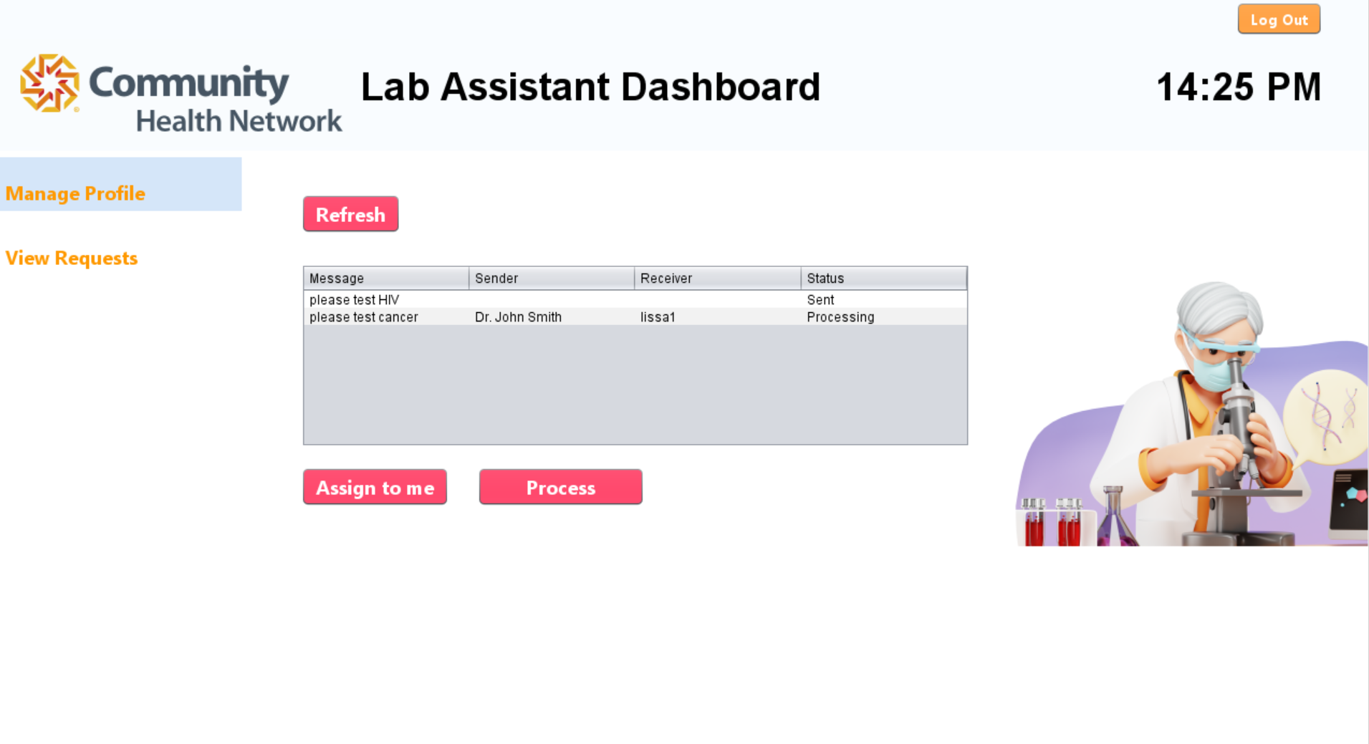
Application Walkthrough

Slide 20
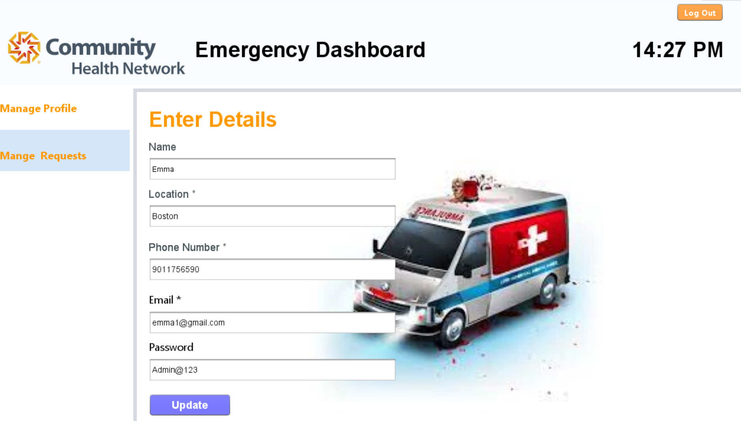
Application Walkthrough

Slide 21
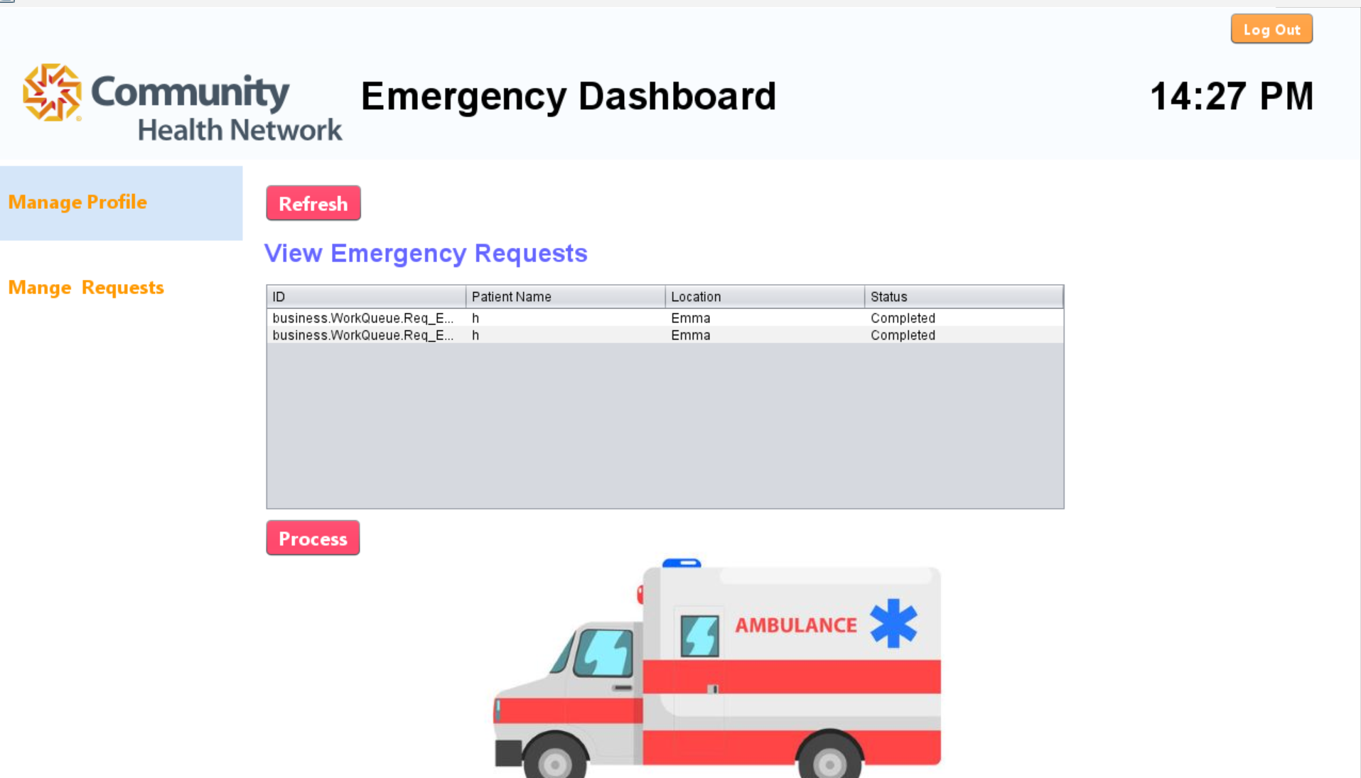
Application Walkthrough

Slide 22
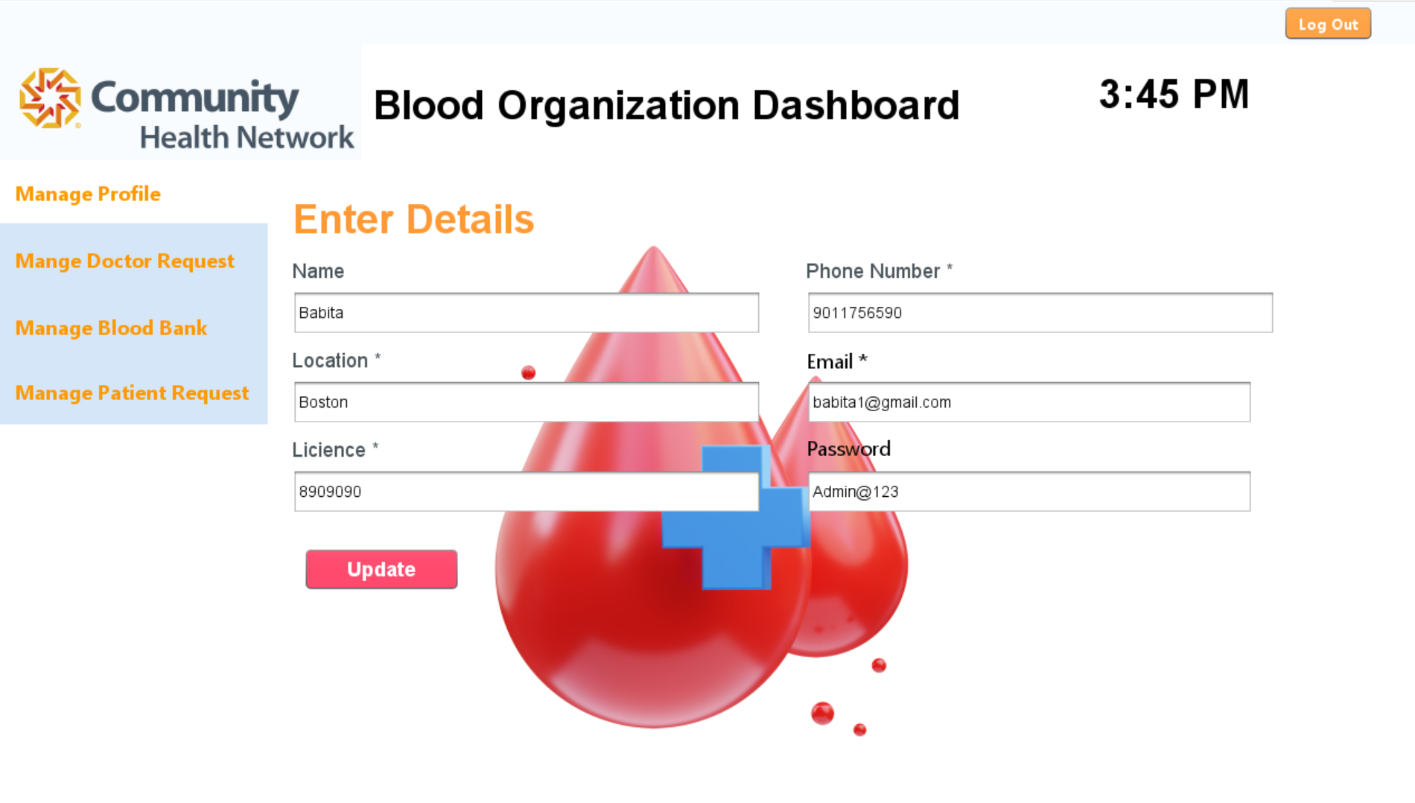
Application Walkthrough

Slide 23
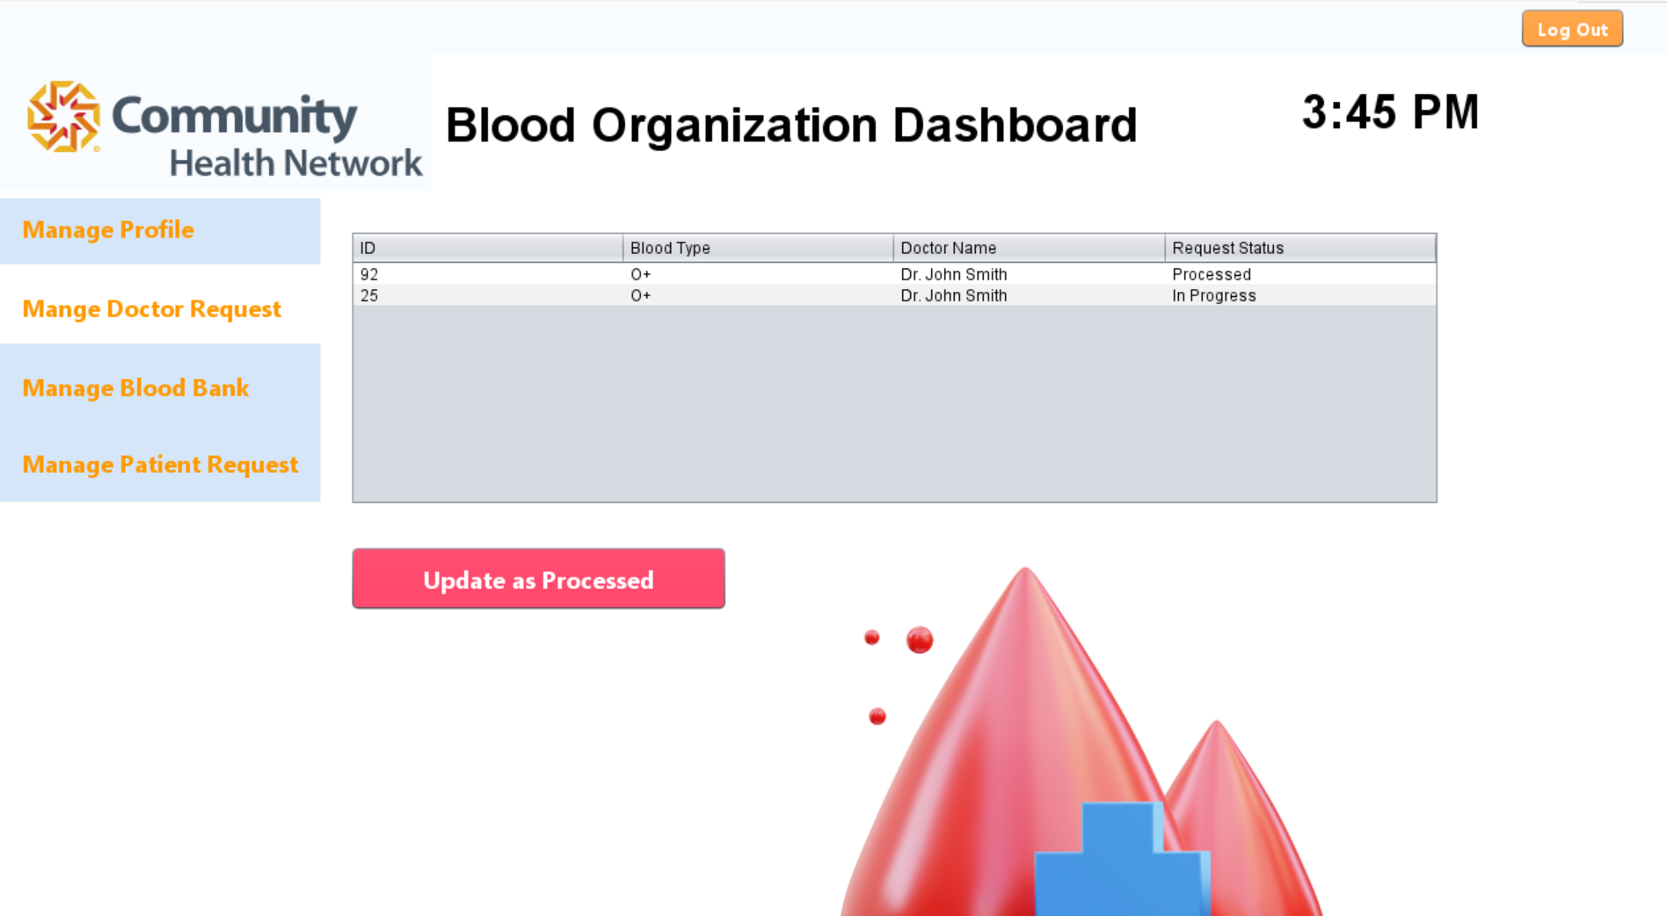
Application Walkthrough

Slide 24
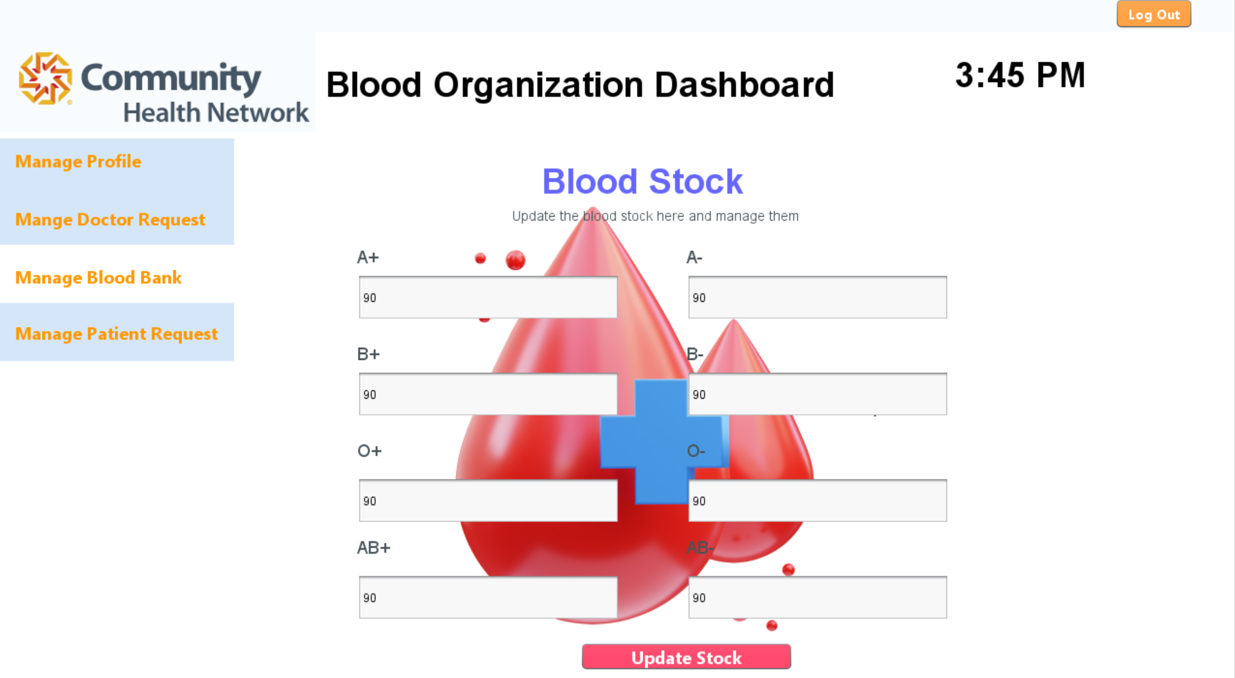
Application Walkthrough

Slide 25
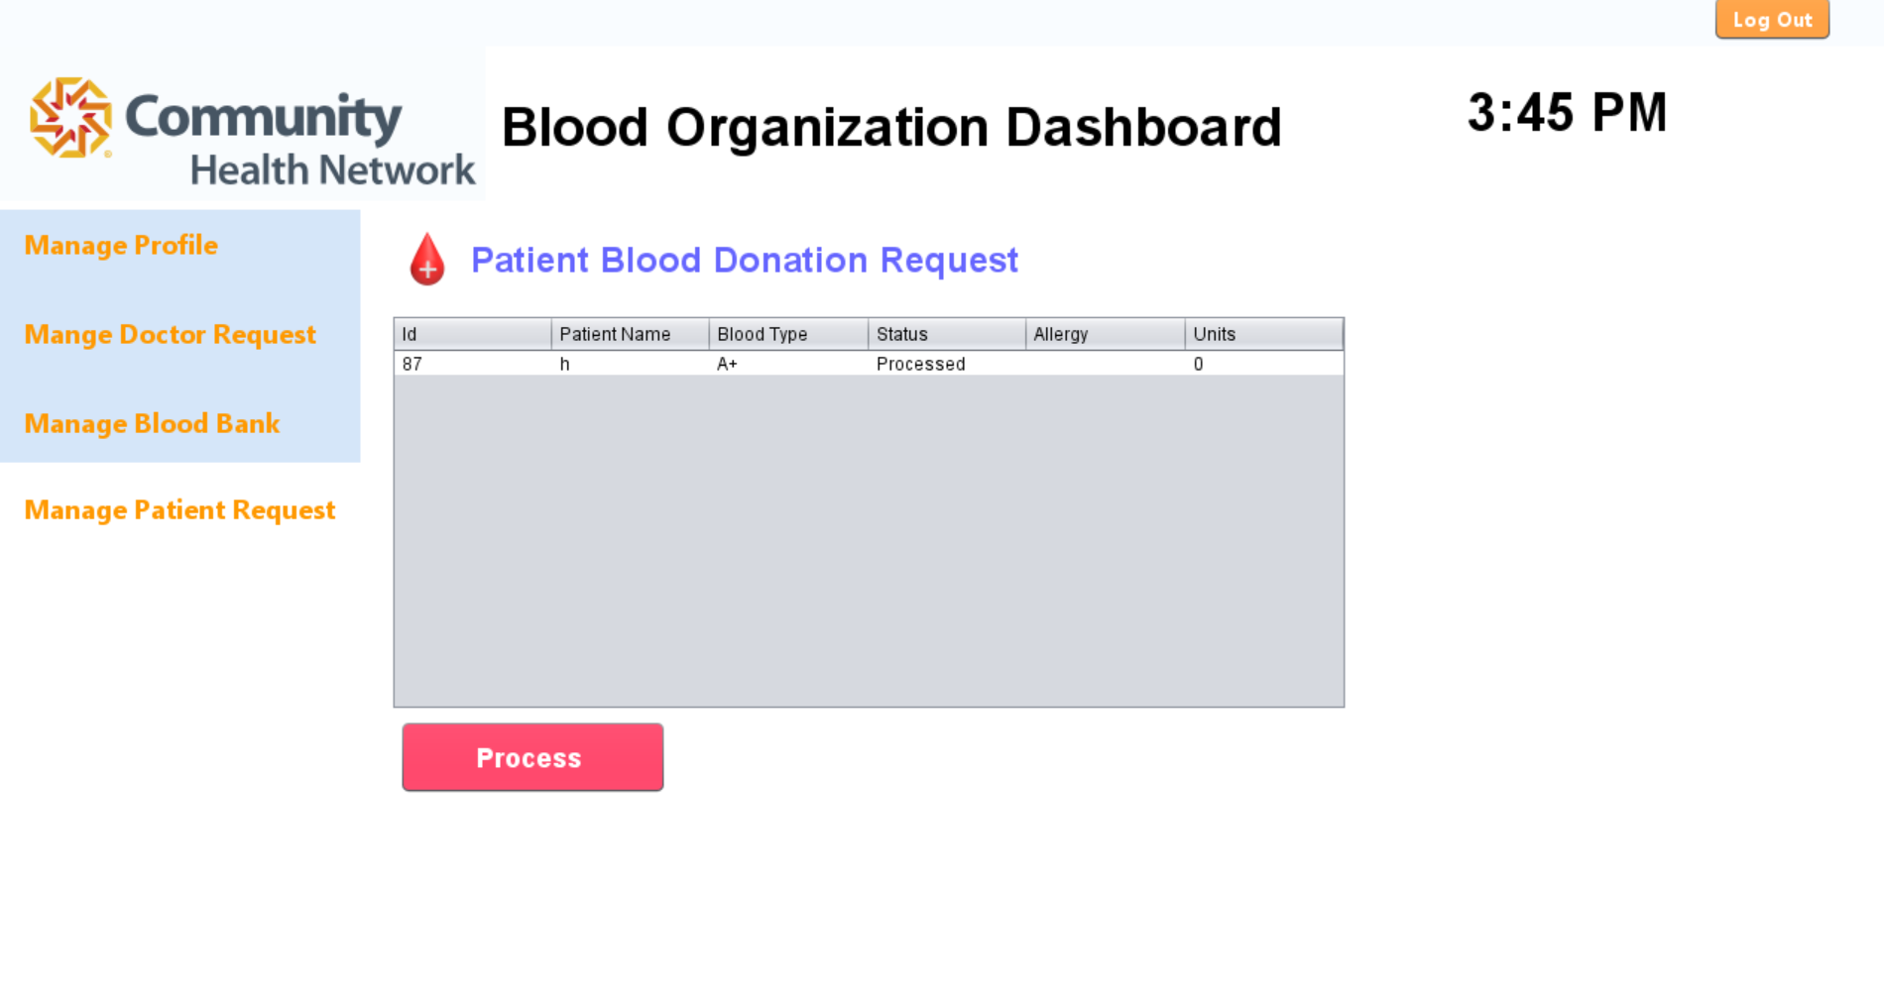
Application Walkthrough

Slide 26
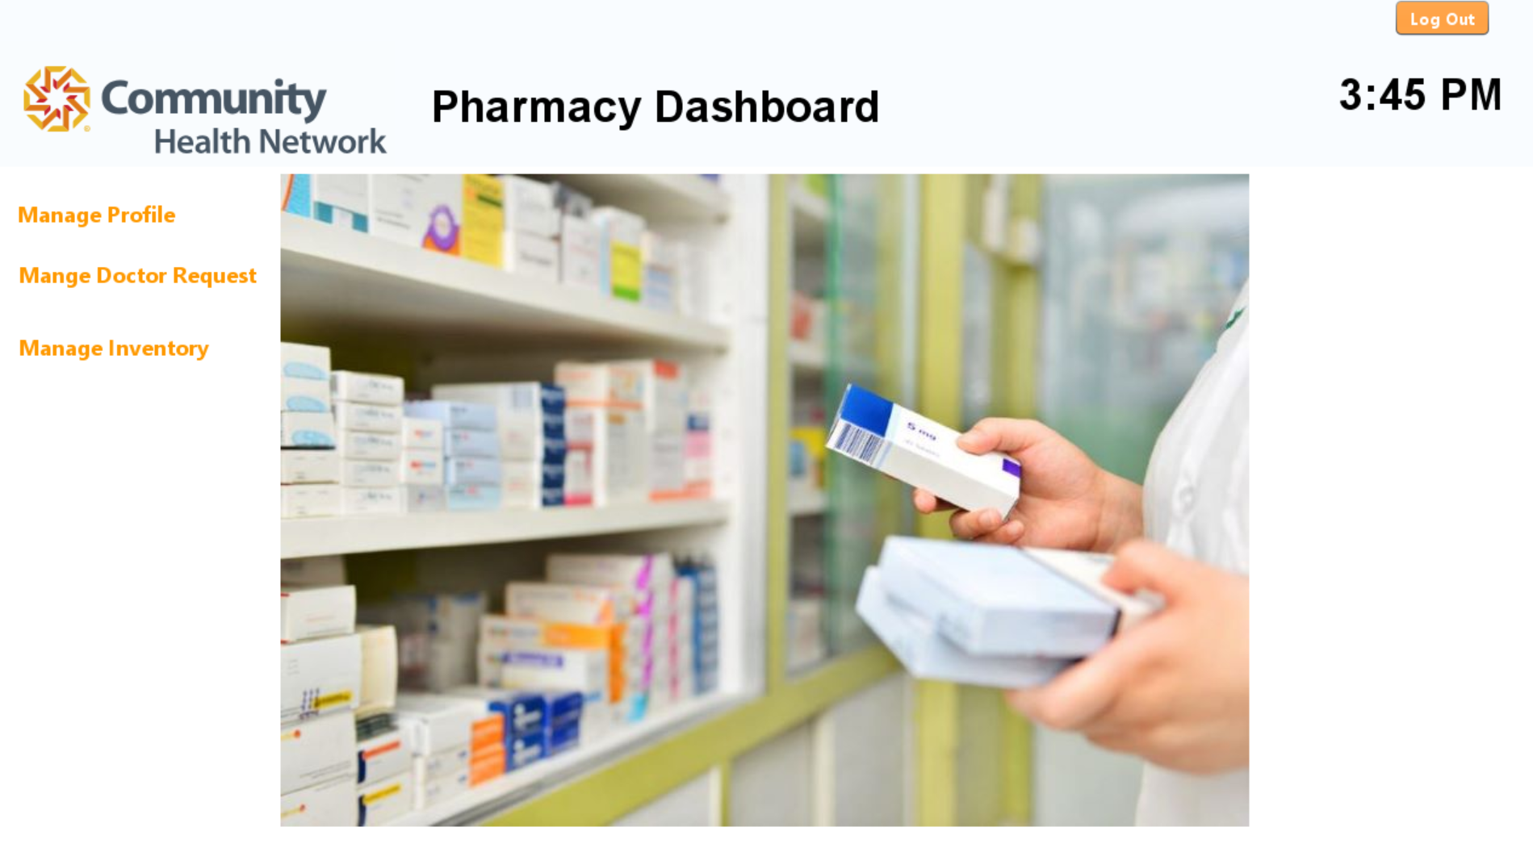
Application Walkthrough

Slide 27
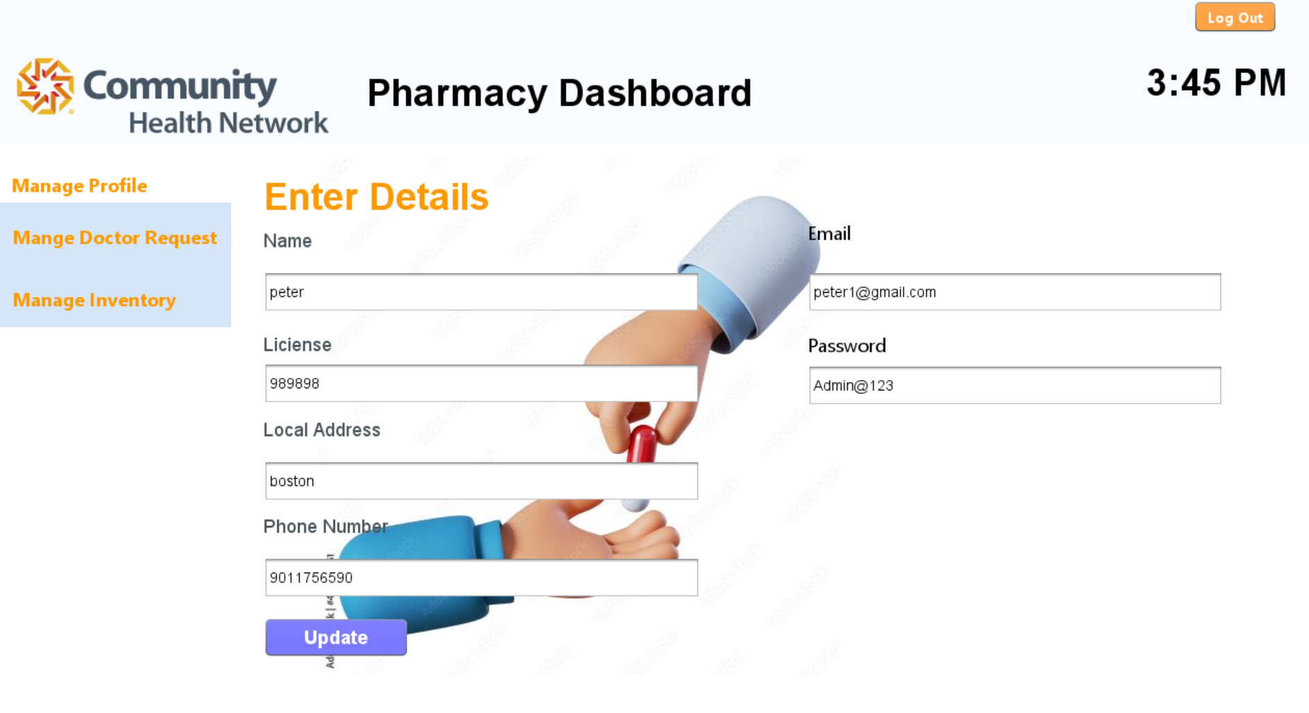
Application Walkthrough

Slide 28
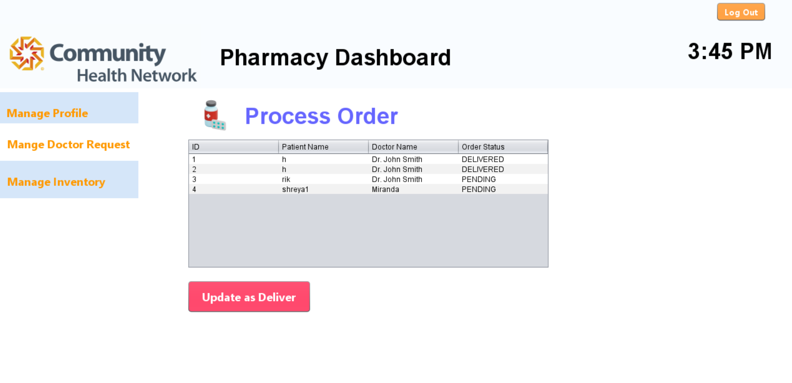
Application Walkthrough

Slide 29
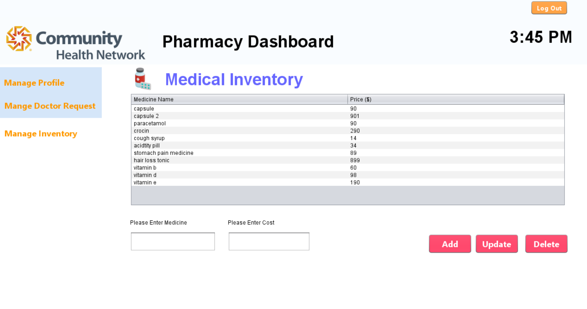
Application Walkthrough

Slide 30
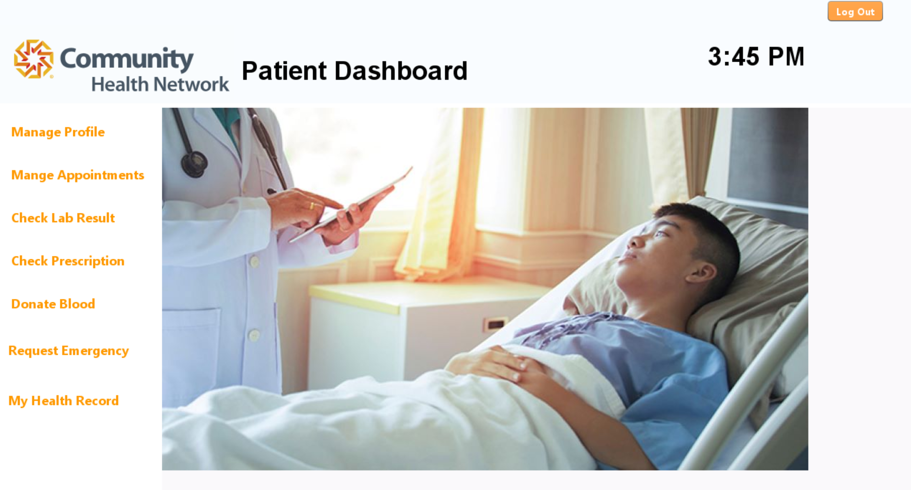
Application Walkthrough

Slide 31
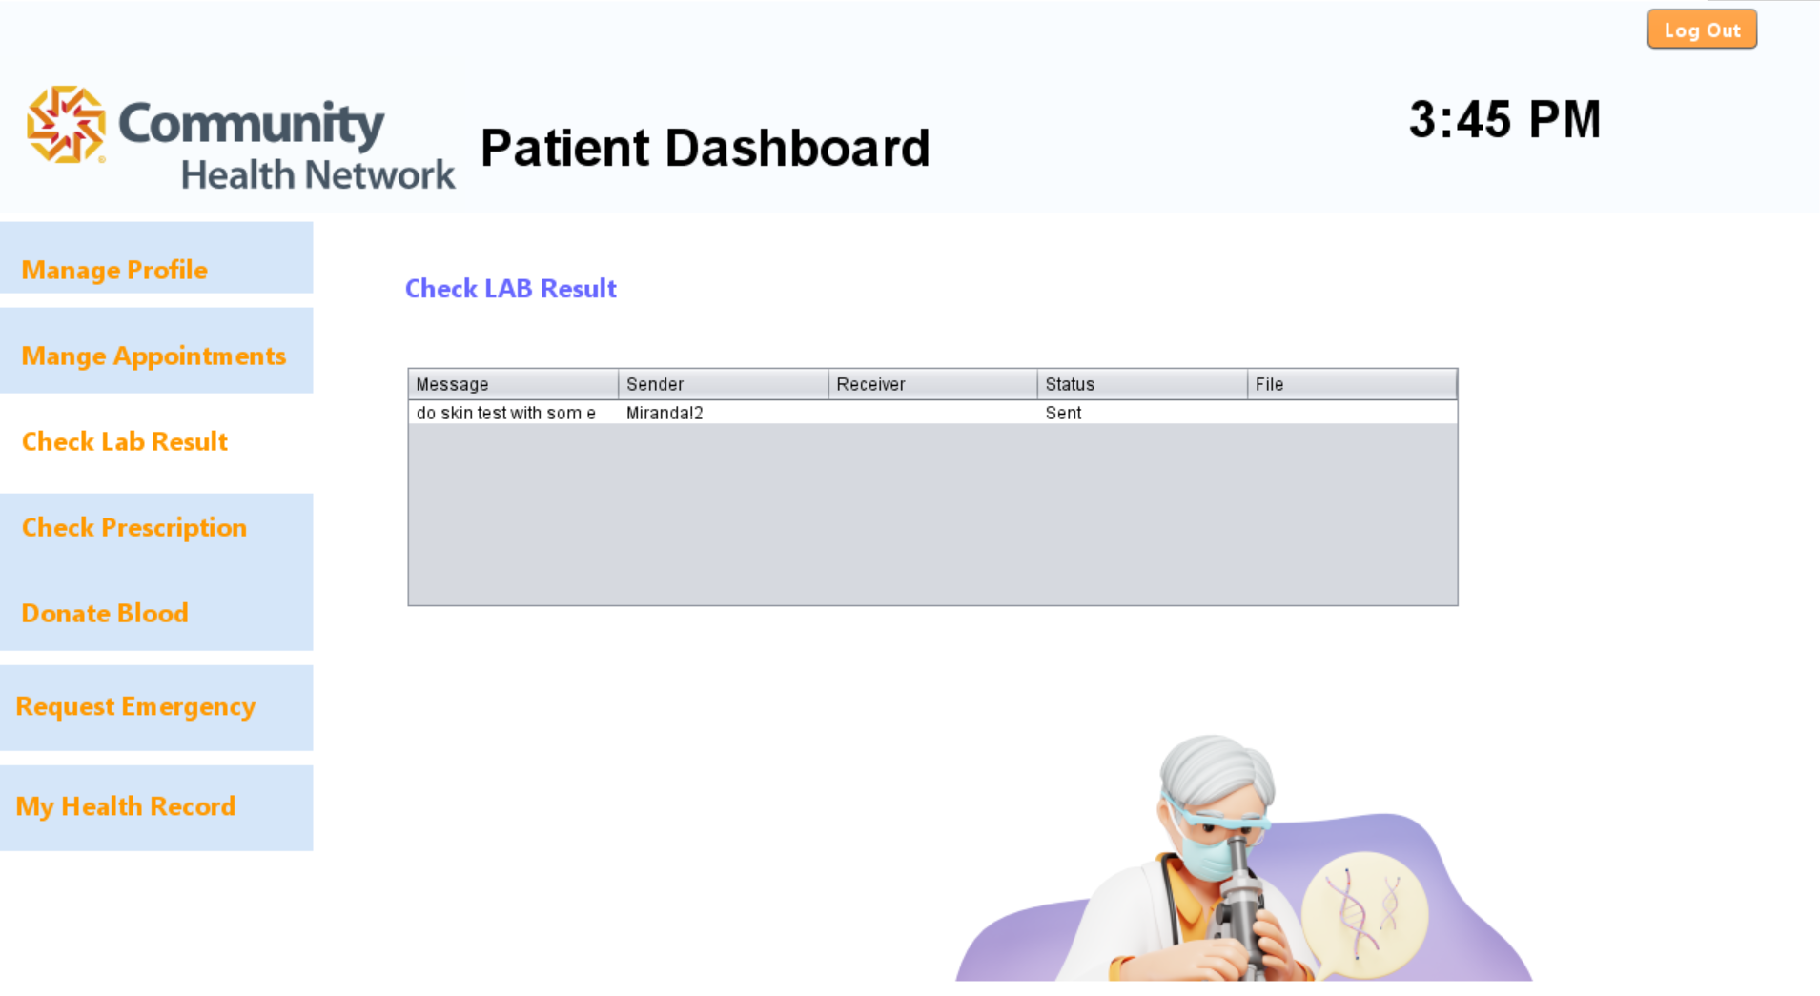
Application Walkthrough

Slide 32
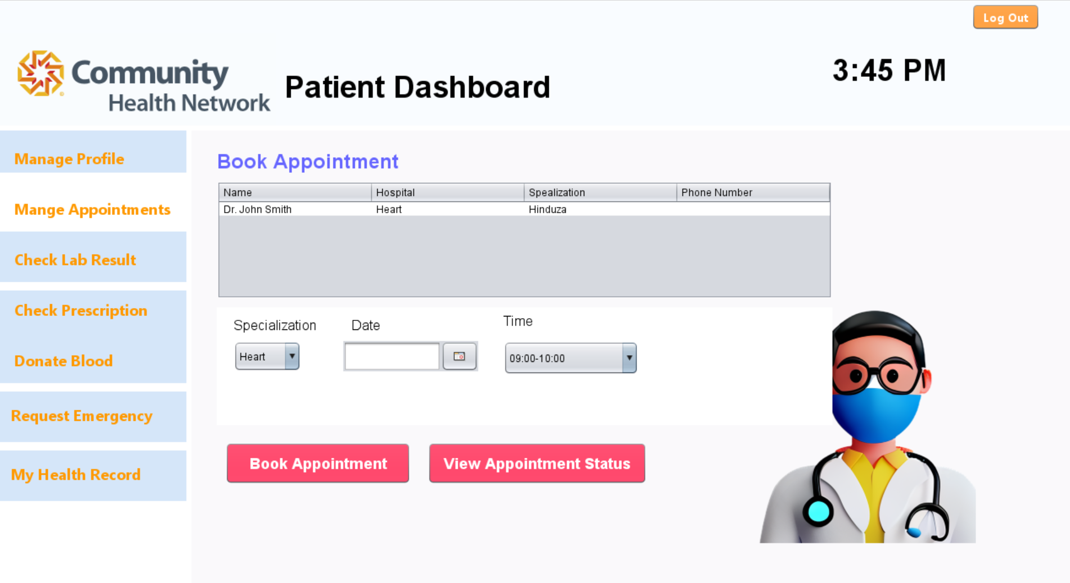
Application Walkthrough

Slide 33
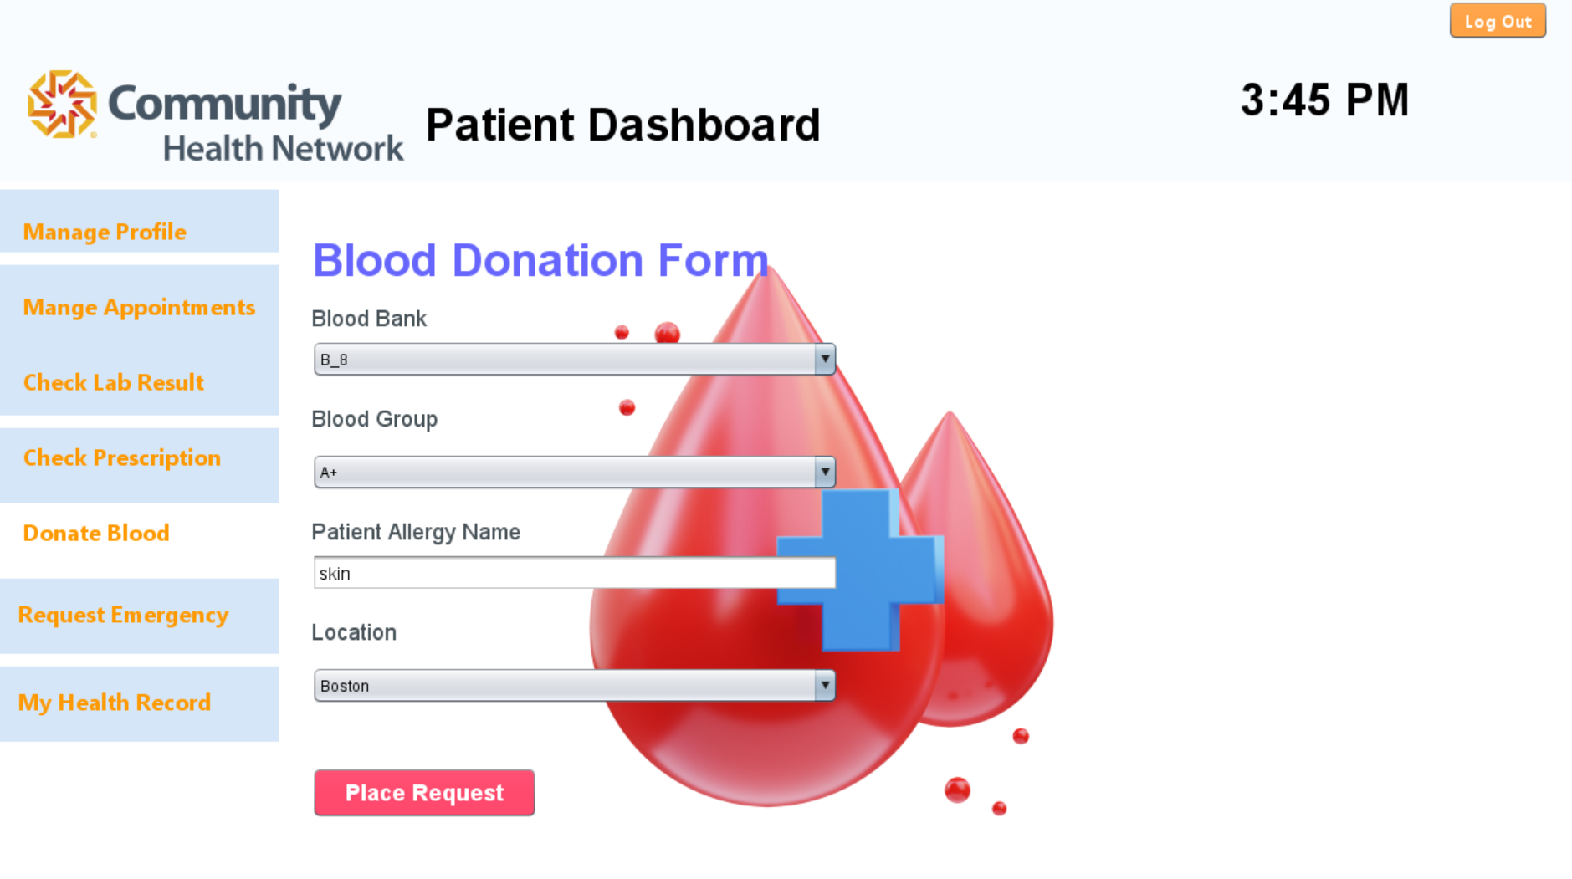
Application Walkthrough

Slide 34
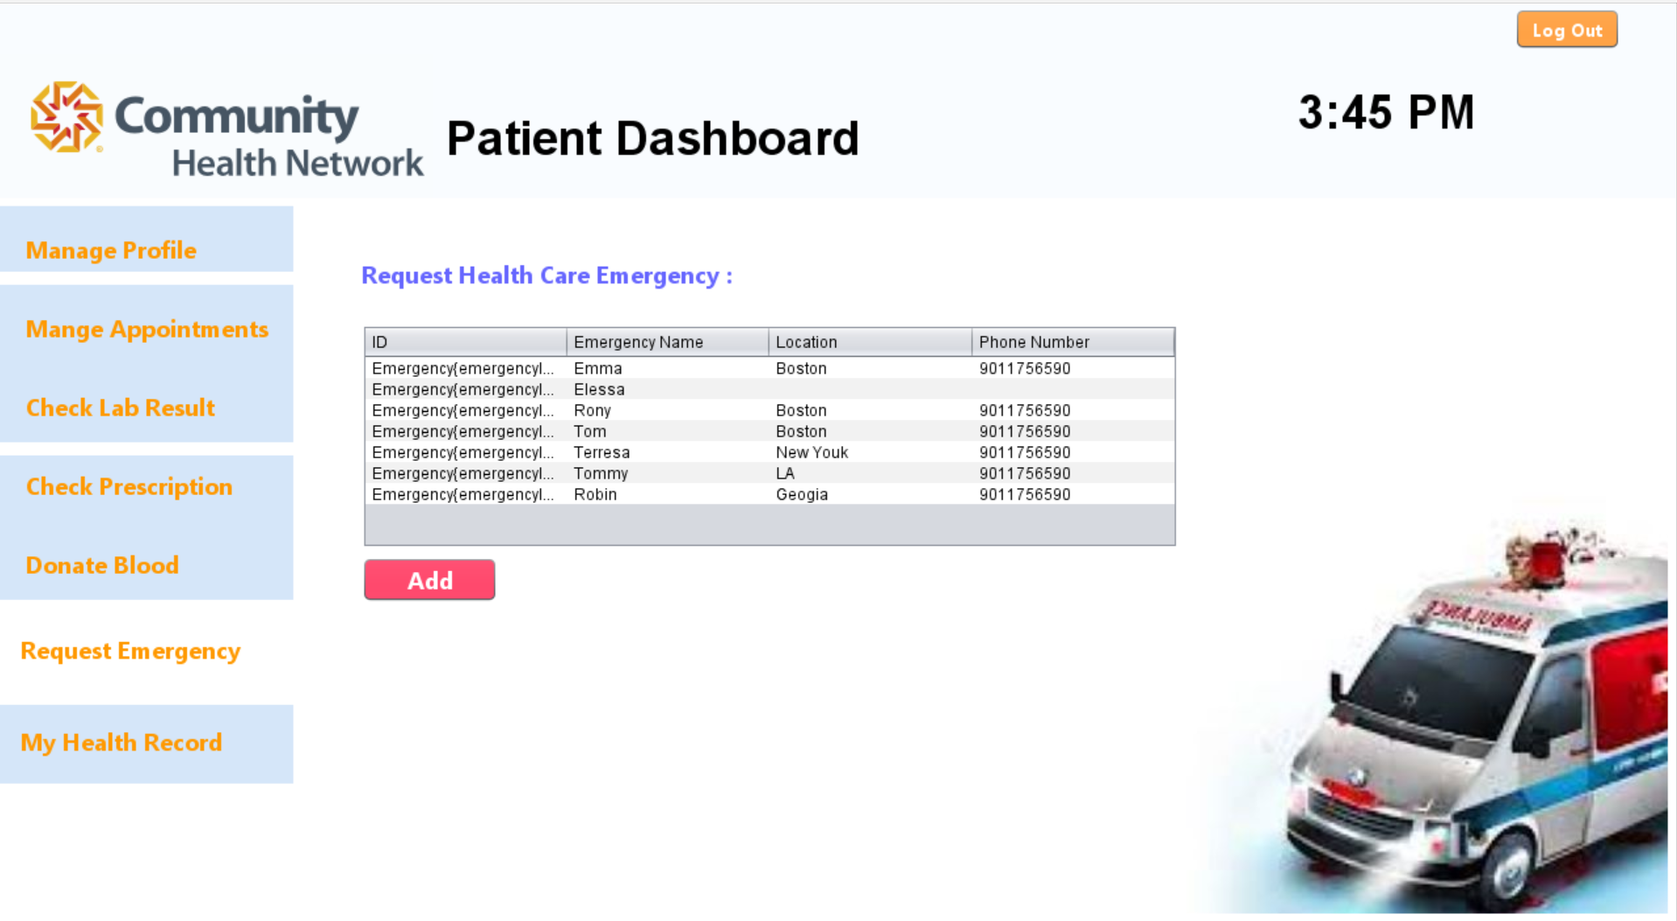
Application Walkthrough

Slide 35
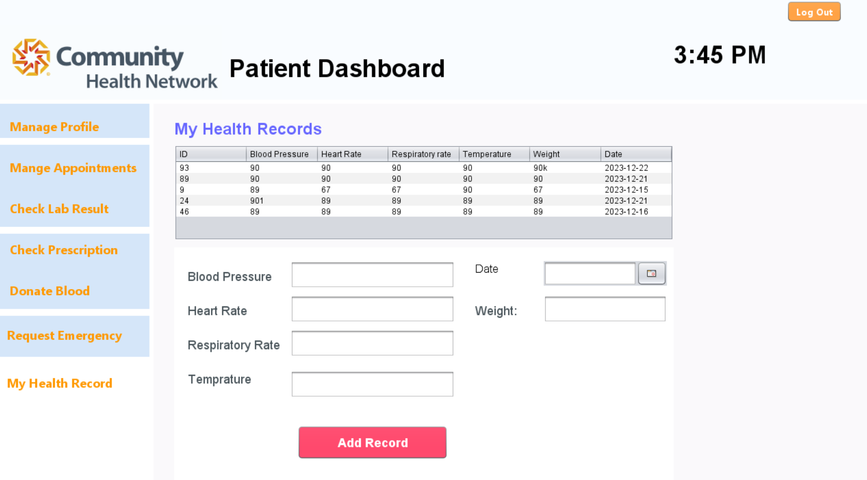
Application Walkthrough

Slide 36
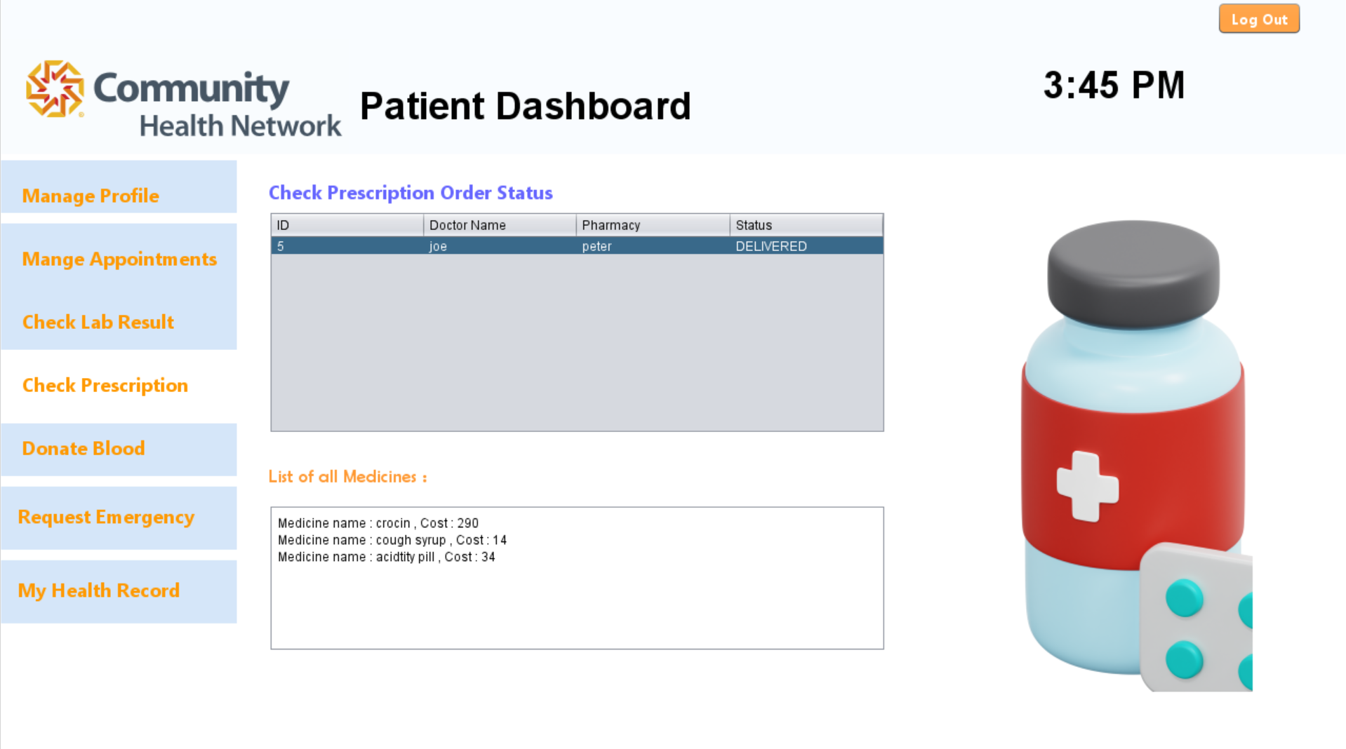
Application Walkthrough

Slide 37

Thank you

